Slide 1
Linear Discriminant Analysis 生醫光電所 吳育德
Chap7. A First Course in Machine Learning, 2ed, Simon Rogers and Mark Girolami, 2017
CSC421/2516 Lecture 12, Roger Grosse and Jimmy Ba, Univ. of Toronto

Slide 2
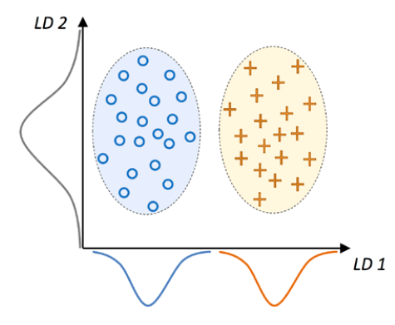
The General Problem
Given training samples of i classes, determine a set of optimal projection axes such that the set of projective feature vectors has the maximum between-class scatter and minimum within-class scatter simultaneously.

Slide 3
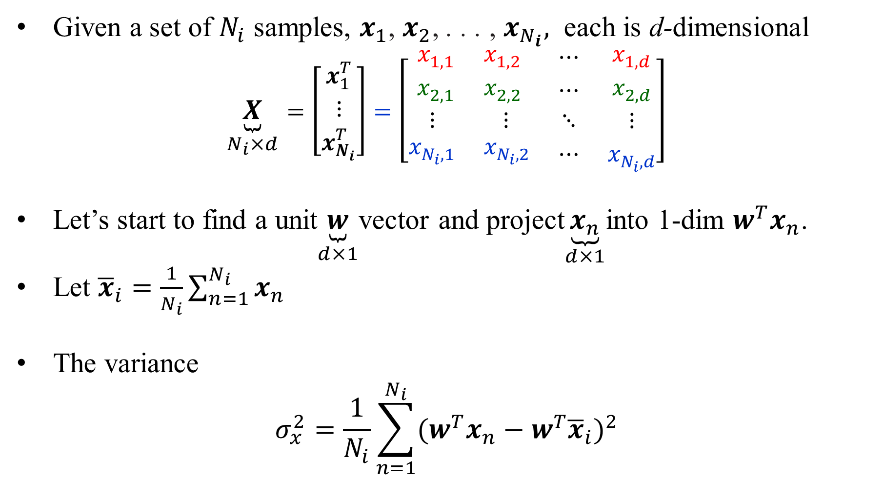
Projection of data $x_{1}$, $x_{2}$, . . . ,$x_{N_{i}}$in a class i onto vector w
Given a set of $N_{i}$ samples, $x_{1}$, $x_{2}$, . . . , $x_{N_{i}},$ each is d-dimensional
$$\underset{N_{i}×d}{\underbrace{X}}=\left[\begin{matrix}x_{1}^{T} \\ ⋮ \\ x_{N_{i}}^{T}\end{matrix}\right]=\left[\begin{matrix}\begin{matrix}x_{1,1} & x_{1,2} \\ x_{2,1} & x_{2,2}\end{matrix} & \begin{matrix}⋯ \\ ⋯\end{matrix} & \begin{matrix}x_{1,d} \\ x_{2,d}\end{matrix} \\ \begin{matrix}⋮ & ⋮\end{matrix} & ⋱ & ⋮ \\ \begin{matrix}x_{N_{i},1} & x_{N_{i},2}\end{matrix} & ⋯ & x_{N_{i},d}\end{matrix}\right]$$
Let’s start to find a unit$\underset{d×1}{\underbrace{w}}$vector and project$\underset{d×1}{\underbrace{x_{n}}}$into 1-dim $w^{T}x_{n}$.
Let ${\overline{x}}_{i}=\frac{1}{N_{i}}\sum_{n=1}^{N_{i}}{x_{n}}$
The variance
$$σ_{x}^{2}=\frac{1}{N_{i}}\sum_{n=1}^{N_{i}}{{(w^{T}x_{n}−w^{T}{\overline{x}}_{i})}^{2}}$$

Slide 4
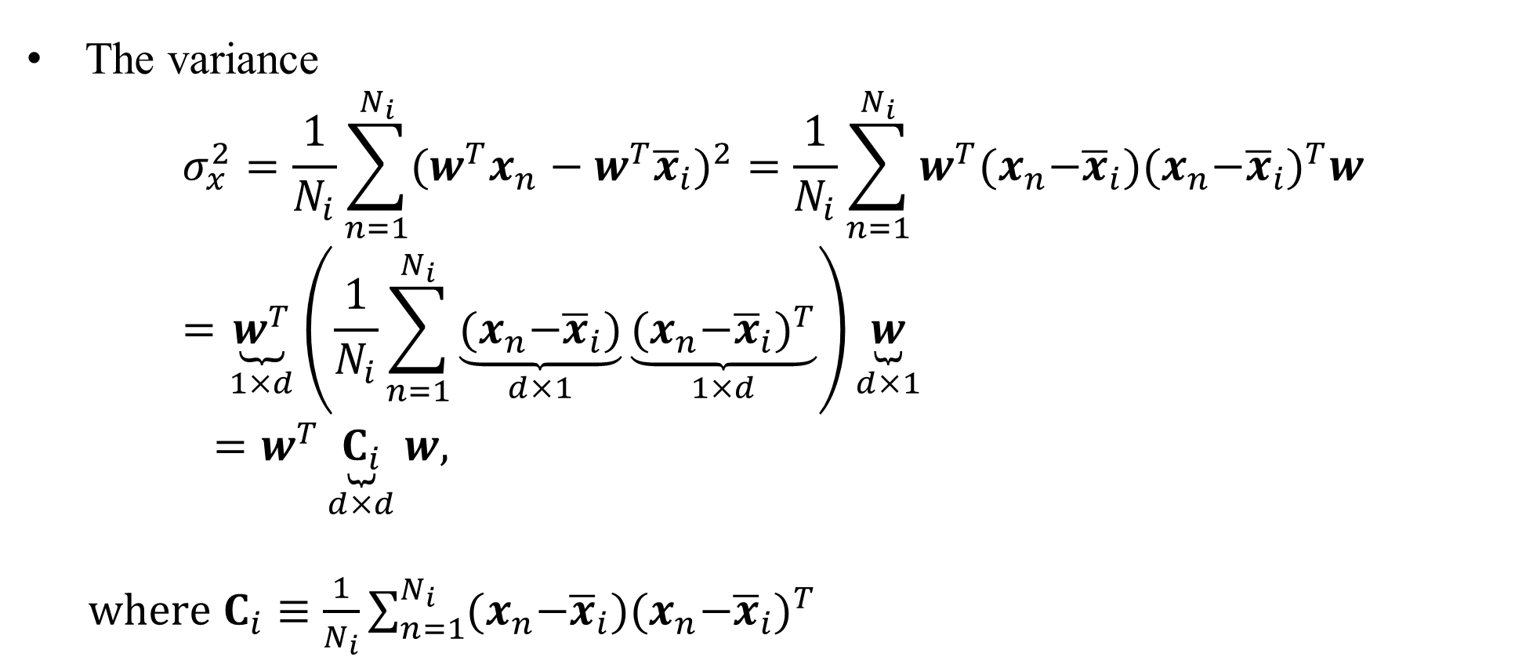
Projection of data $x_{1}$, $x_{2}$, . . . , $x_{N_{i}}$ in a class i onto vector w
The variance
$$σ_{x}^{2}=\frac{1}{N_{i}}\sum_{n=1}^{N_{i}}{{(w^{T}x_{n}−w^{T}{\overline{x}}_{i})}^{2}}=\frac{1}{N_{i}}\sum_{n=1}^{N_{i}}{w^{T}{(x}_{n}−{\overline{x}}_{i}){{(x}_{n}−{\overline{x}}_{i})}^{T}w}=\underset{1×d}{\underbrace{w^{T}}}\left(\frac{1}{N_{i}}\sum_{n=1}^{N_{i}}{\underset{d×1}{\underbrace{{(x}_{n}−{\overline{x}}_{i})}}\underset{1×d}{\underbrace{{{(x}_{n}−{\overline{x}}_{i})}^{T}}}}\right)\underset{d×1}{\underbrace{w}}$$
$=w^{T}\underset{d×d}{\underbrace{C_{i}}}w,$
$where C_{i}≡\frac{1}{N_{i}}\sum_{n=1}^{N_{i}}{{(x}_{n}−{\overline{x}}_{i}){{(x}_{n}−{\overline{x}}_{i})}^{T} }$

Slide 5
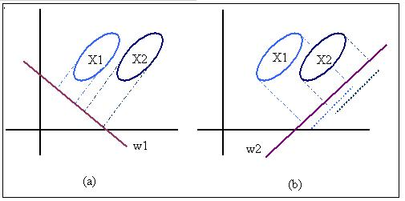
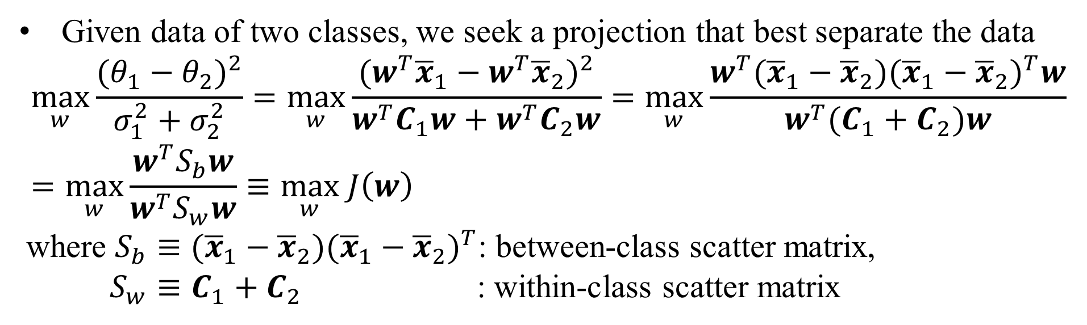
Linear (Fisher’s) Discriminant Analysis (LDA) for 2 Classes
Given data of two classes, we seek a projection that best separate the data
$$\max_{w}{\frac{{(θ_{1}−θ_{2})}^{2}}{σ_{1}^{2}+σ_{2}^{2}}}=\max_{w}\frac{{(w^{T}{\overline{x}}_{1}−w^{T}{\overline{x}}_{2})}^{2}}{w^{T}C_{1}w+w^{T}C_{2}w}=\max_{w}\frac{w^{T}({\overline{x}}_{1}−{\overline{x}}_{2}){({\overline{x}}_{1}−{\overline{x}}_{2})}^{T}w}{w^{T}(C_{1}+C_{2})w}=\max_{w}\frac{w^{T}S_{b}w}{w^{T}S_{w}w}≡\max_{w} J\left(w\right)$$
where $S_{b}≡({\overline{x}}_{1}−{\overline{x}}_{2}){({\overline{x}}_{1}−{\overline{x}}_{2})}^{T}$: between-class scatter matrix,
$S_{w}≡C_{1}+C_{2}$ : within-class scatter matrix

Slide 6
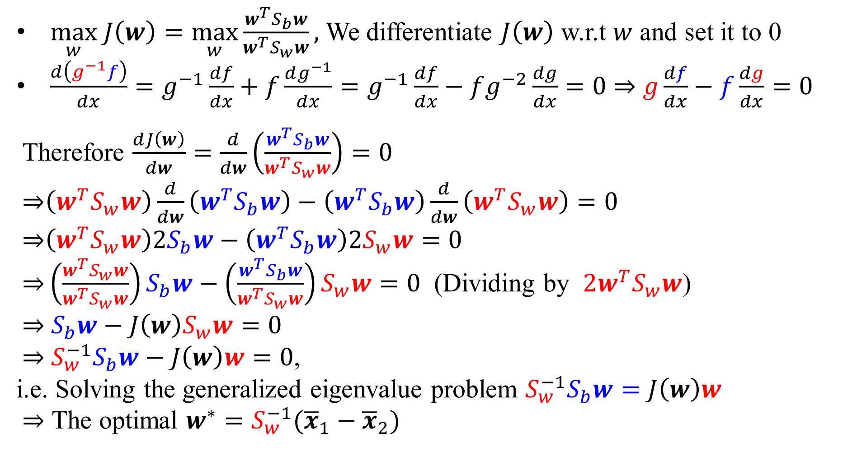
LDA for 2 Classes: The first derivation method
$\max_{w} J\left(w\right)=\max_{w}\frac{w^{T}S_{b}w}{w^{T}S_{w}w},$ We differentiate $J\left(w\right)$ w.r.t $w$ and set it to 0
$\frac{d\left(g^{−1}f\right)}{dx}=g^{−1}\frac{df}{dx}+f\frac{dg^{−1}}{dx}=g^{−1}\frac{df}{dx}−fg^{−2}\frac{dg}{dx}=0$ ⇒ $g\frac{df}{dx}−f\frac{dg}{dx}=0$
Therefore $\frac{dJ\left(w\right)}{dw}=\frac{d}{dw}\left(\frac{w^{T}S_{b}w}{w^{T}S_{w}w}\right)=0$
$\text{⇒}\left(w^{T}S_{w}w\right)\frac{d}{dw}\left(w^{T}S_{b}w\right)−\left(w^{T}S_{b}w\right)\frac{d}{dw}\left(w^{T}S_{w}w\right)=0$
$\text{⇒}\left(w^{T}S_{w}w\right)2S_{b}w−\left(w^{T}S_{b}w\right)2S_{w}w=0$
$\text{⇒}\left(\frac{w^{T}S_{w}w}{w^{T}S_{w}w}\right)S_{b}w−\left(\frac{w^{T}S_{b}w}{w^{T}S_{w}w}\right)S_{w}w=0$ (Dividing by $2w^{T}S_{w}w$)
$\text{⇒} S_{b}w−J\left(w\right)S_{w}w=0$
$\text{⇒} S_{w}^{−1}S_{b}w−J\left(w\right)w=0$,
i.e. Solving the generalized eigenvalue problem $S_{w}^{−1}S_{b}w=J\left(w\right)w$
$\text{⇒}$ The optimal $w^{∗}=S_{w}^{−1}({\overline{x}}_{1}−{\overline{x}}_{2})$

Slide 7
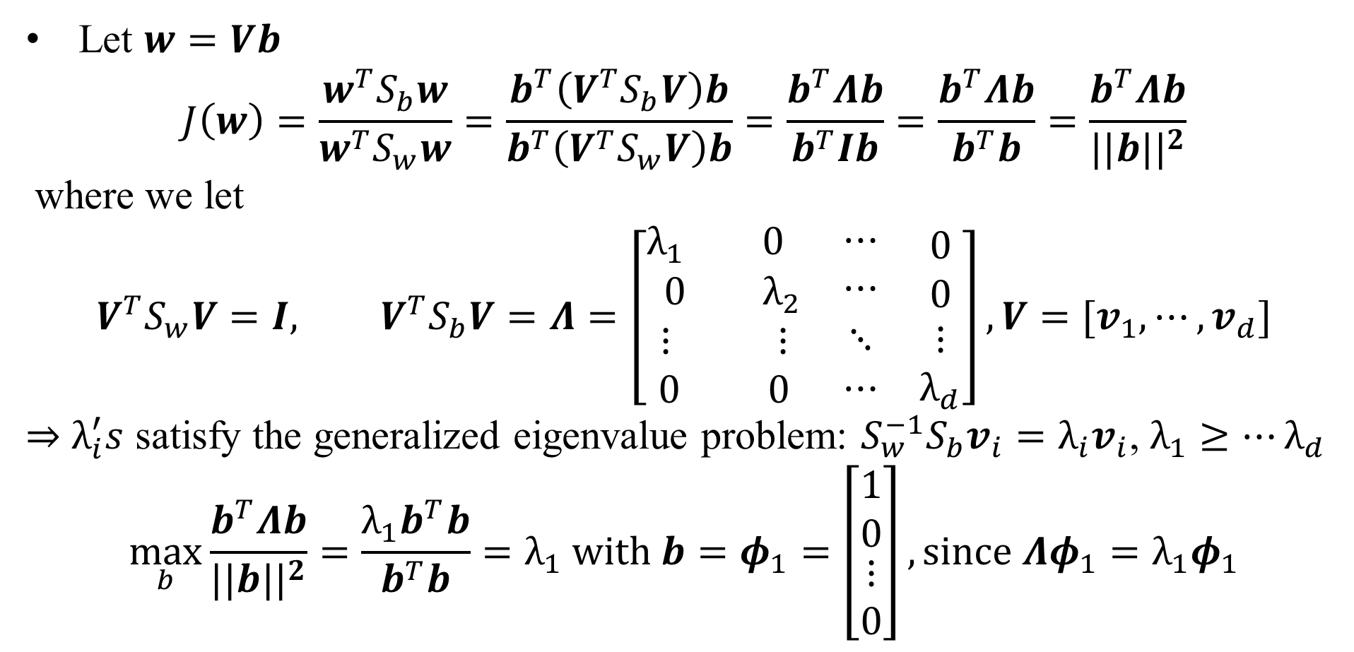
LDA for 2 Classes: The second derivation method
Let $w=Vb$
$$J\left(w\right)=\frac{w^{T}S_{b}w}{w^{T}S_{w}w}=\frac{b^{T}\left(V^{T}S_{b}V\right)b}{b^{T}\left(V^{T}S_{w}V\right)b}=\frac{b^{T}Λb}{b^{T}Ib}=\frac{b^{T}Λb}{b^{T}b}=\frac{b^{T}Λb}{{||b||}^{2}}$$
where we let
$$V^{T}S_{w}V=I, V^{T}S_{b}V=Λ=\left[\begin{matrix}\begin{matrix}λ_{1} & 0 \\ 0 & λ_{2}\end{matrix} & \begin{matrix}⋯ \\ ⋯\end{matrix} & \begin{matrix}0 \\ 0\end{matrix} \\ \begin{matrix}⋮ & ⋮\end{matrix} & ⋱ & ⋮ \\ \begin{matrix}0 & 0\end{matrix} & ⋯ & λ_{d}\end{matrix}\right], V=[v_{1},⋯,v_{d}]$$
⇒ $λ_{i}^{′}s$ satisfy the generalized eigenvalue problem: ${S_{w}^{−1}S}_{b}v_{i}=λ_{i}v_{i}$, $λ_{1}≥⋯λ_{d}$
$$\max_{b}\frac{b^{T}Λb}{{||b||}^{2}}=\frac{λ_{1}b^{T}b}{b^{T}b}=λ_{1} with b=φ_{1}=\left[\begin{matrix}\begin{matrix}1 \\ 0\end{matrix} \\ \begin{matrix}⋮ \\ 0\end{matrix}\end{matrix}\right], since Λφ_{1}=λ_{1}φ_{1}$$

Slide 8
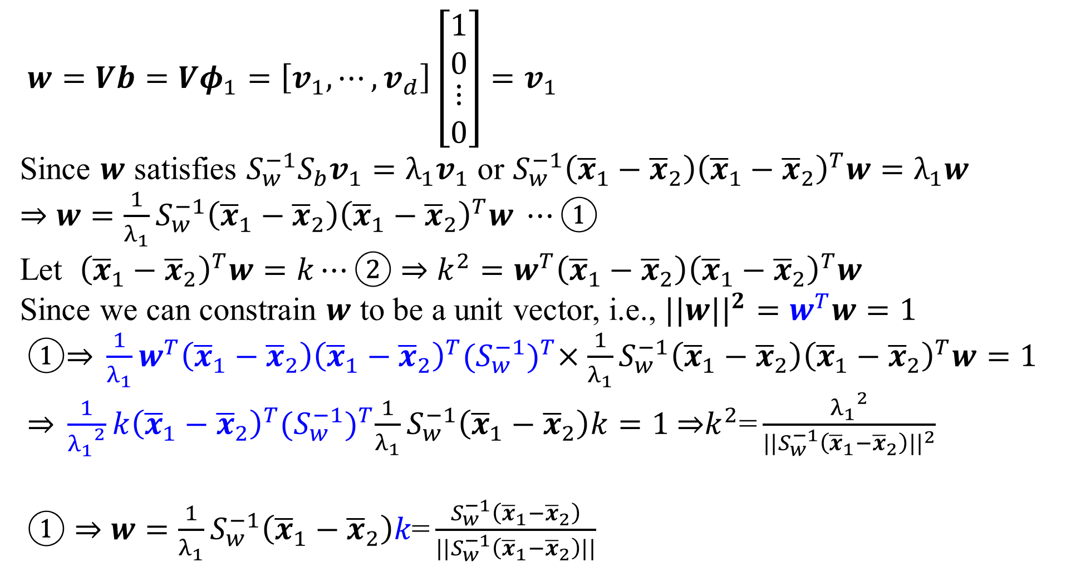
Find the Best Projection Vector w
$w=Vb=Vφ_{1}=\left[v_{1},⋯,v_{d}\right]\left[\begin{matrix}\begin{matrix}1 \\ 0\end{matrix} \\ \begin{matrix}⋮ \\ 0\end{matrix}\end{matrix}\right]=v_{1}$
Since $w$ satisfies ${S_{w}^{−1}S}_{b}v_{1}=λ_{1}v_{1}$ or $S_{w}^{−1}\left({\overline{x}}_{1}−{\overline{x}}_{2}\right){\left({\overline{x}}_{1}−{\overline{x}}_{2}\right)}^{T}w=λ_{1}w$
⇒ $w=\frac{1}{λ_{1}}S_{w}^{−1}\left({\overline{x}}_{1}−{\overline{x}}_{2}\right){\left({\overline{x}}_{1}−{\overline{x}}_{2}\right)}^{T}w ⋯①$
Let ${\left({\overline{x}}_{1}−{\overline{x}}_{2}\right)}^{T}w=k⋯②$ ⇒ $k^{2}={w^{T}\left({\overline{x}}_{1}−{\overline{x}}_{2}\right)\left({\overline{x}}_{1}−{\overline{x}}_{2}\right)}^{T}w$
Since we can constrain $w$ to be a unit vector, i.e., ${||w||}^{2}=w^{T}w=1$
$①\text{⇒} \frac{1}{λ_{1}}w^{T}\left({\overline{x}}_{1}−{\overline{x}}_{2}\right){\left({\overline{x}}_{1}−{\overline{x}}_{2}\right)}^{T}{(S_{w}^{−1})}^{T}×\frac{1}{λ_{1}}S_{w}^{−1}\left({\overline{x}}_{1}−{\overline{x}}_{2}\right){\left({\overline{x}}_{1}−{\overline{x}}_{2}\right)}^{T}w=1$
$\text{⇒} \frac{1}{{λ_{1}}^{2}}k{\left({\overline{x}}_{1}−{\overline{x}}_{2}\right)}^{T}{(S_{w}^{−1})}^{T}\frac{1}{λ_{1}}S_{w}^{−1}\left({\overline{x}}_{1}−{\overline{x}}_{2}\right)k=1 \text{⇒}k^{2}\text{=}\frac{{λ_{1}}^{2}}{{||S_{w}^{−1}\left({\overline{x}}_{1}−{\overline{x}}_{2}\right)||}^{2}}$
$①$ $\text{⇒}$ $w=\frac{1}{λ_{1}}S_{w}^{−1}\left({\overline{x}}_{1}−{\overline{x}}_{2}\right)k\text{=}\frac{S_{w}^{−1}\left({\overline{x}}_{1}−{\overline{x}}_{2}\right)}{||S_{w}^{−1}\left({\overline{x}}_{1}−{\overline{x}}_{2}\right)||}$

Slide 9
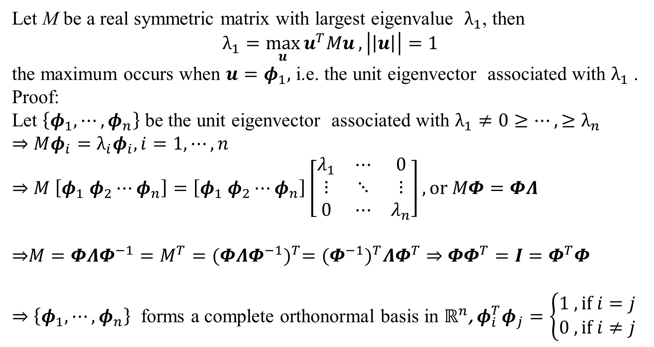
Theorem: eigendecomposition
Let M be a real symmetric matrix with largest eigenvalue $λ_{1}$, then
$$λ_{1}=\max_{u}{u^{T}Mu}, \left|\left|u\right|\right|=1$$
the maximum occurs when $u=φ_{1},$ i.e. the unit eigenvector associated with $λ_{1}$ .
Proof:
Let $\left\{φ_{1}, ⋯,φ_{n}\right\}$ be the unit eigenvector associated with $λ_{1}≠0≥⋯,≥λ_{n}$
⇒ $Mφ_{i}=λ_{i}φ_{i}, i=1,⋯,n$
⇒ $M \left[φ_{1} φ_{2}⋯φ_{n}\right]=\left[φ_{1} φ_{2}⋯φ_{n}\right]\left[\begin{matrix}λ_{1} & ⋯ & 0 \\ ⋮ & ⋱ & ⋮ \\ 0 & ⋯ & λ_{n}\end{matrix}\right], or MΦ=ΦΛ$
⇒$M=ΦΛΦ^{−1}=M^{T}={(ΦΛΦ^{−1})}^{T}={(Φ^{−1})}^{T}ΛΦ^{T}$ ⇒ $ΦΦ^{T}=I=Φ^{T}Φ$
⇒ $\left\{φ_{1}, ⋯,φ_{n}\right\}$ forms a complete orthonormal basis in $ℝ^{n}$, $φ_{i}^{T}φ_{j}=\left\{\begin{aligned}1 , if i=j \\ 0 , if i≠j\end{aligned}\right.$

Slide 10
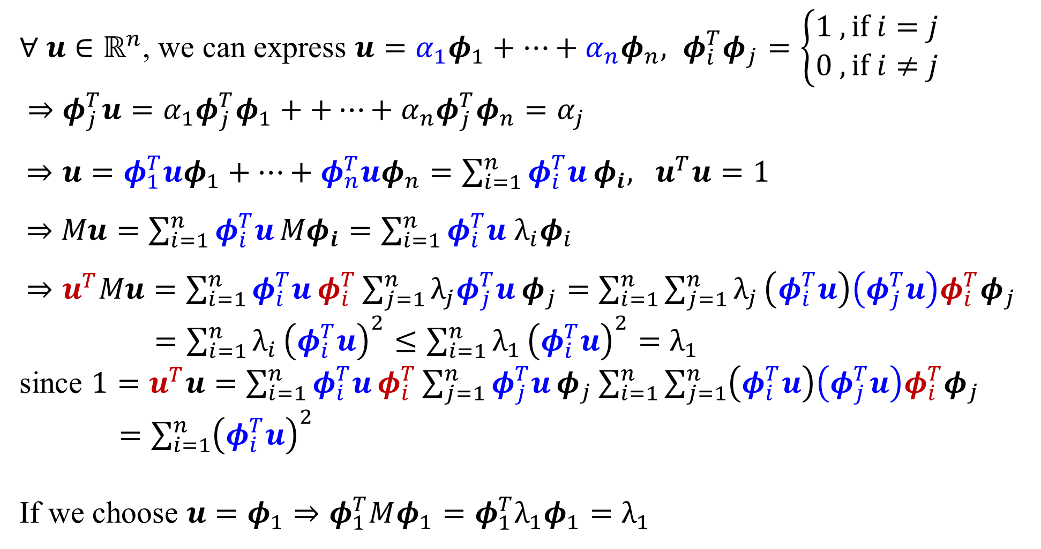
Theorem: eigendecomposition
$∀ {u∈ℝ}^{n}$, we can express $u=α_{1}φ_{1}+⋯+α_{n}φ_{n}, φ_{i}^{T}φ_{j}=\left\{\begin{aligned}1 , if i=j \\ 0 , if i≠j\end{aligned}\right.$
⇒ $φ_{j}^{T}u=α_{1}φ_{j}^{T}φ_{1}++⋯+α_{n}φ_{j}^{T}φ_{n}=α_{j}$
$⇒u=φ_{1}^{T}uφ_{1}+⋯+φ_{n}^{T}uφ_{n}=\sum_{i=1}^{n}{φ_{i}^{T}u}φ_{i}, u^{T}u=1$
$⇒$ $Mu=\sum_{i=1}^{n}{φ_{i}^{T}u}{Mφ}_{i}=\sum_{i=1}^{n}{φ_{i}^{T}u}$ $λ_{i}φ_{i}$
$⇒u^{T}Mu=\sum_{i=1}^{n}{φ_{i}^{T}u}φ_{i}^{T}\sum_{j=1}^{n}{λ_{j}φ_{j}^{T}u}φ_{j}=\sum_{i=1}^{n}{\sum_{j=1}^{n}{λ_{j}}}\left(φ_{i}^{T}u\right)\left(φ_{j}^{T}u\right)φ_{i}^{T}φ_{j}$
$=\sum_{i=1}^{n}{λ_{i}}{\left(φ_{i}^{T}u\right)}^{2}≤\sum_{i=1}^{n}{λ_{1}}{\left(φ_{i}^{T}u\right)}^{2}=λ_{1}$
since $1=u^{T}u=\sum_{i=1}^{n}{φ_{i}^{T}u}φ_{i}^{T}\sum_{j=1}^{n}{φ_{j}^{T}u}φ_{j}\sum_{i=1}^{n}{\sum_{j=1}^{n}{\left(φ_{i}^{T}u\right)\left(φ_{j}^{T}u\right)φ_{i}^{T}φ_{j}}}$
$=\sum_{i=1}^{n}{{\left(φ_{i}^{T}u\right)}^{2}}$
If we choose $u=φ_{1}$ $⇒φ_{1}^{T}Mφ_{1}=φ_{1}^{T}λ_{1}φ_{1}=λ_{1}$

Slide 11
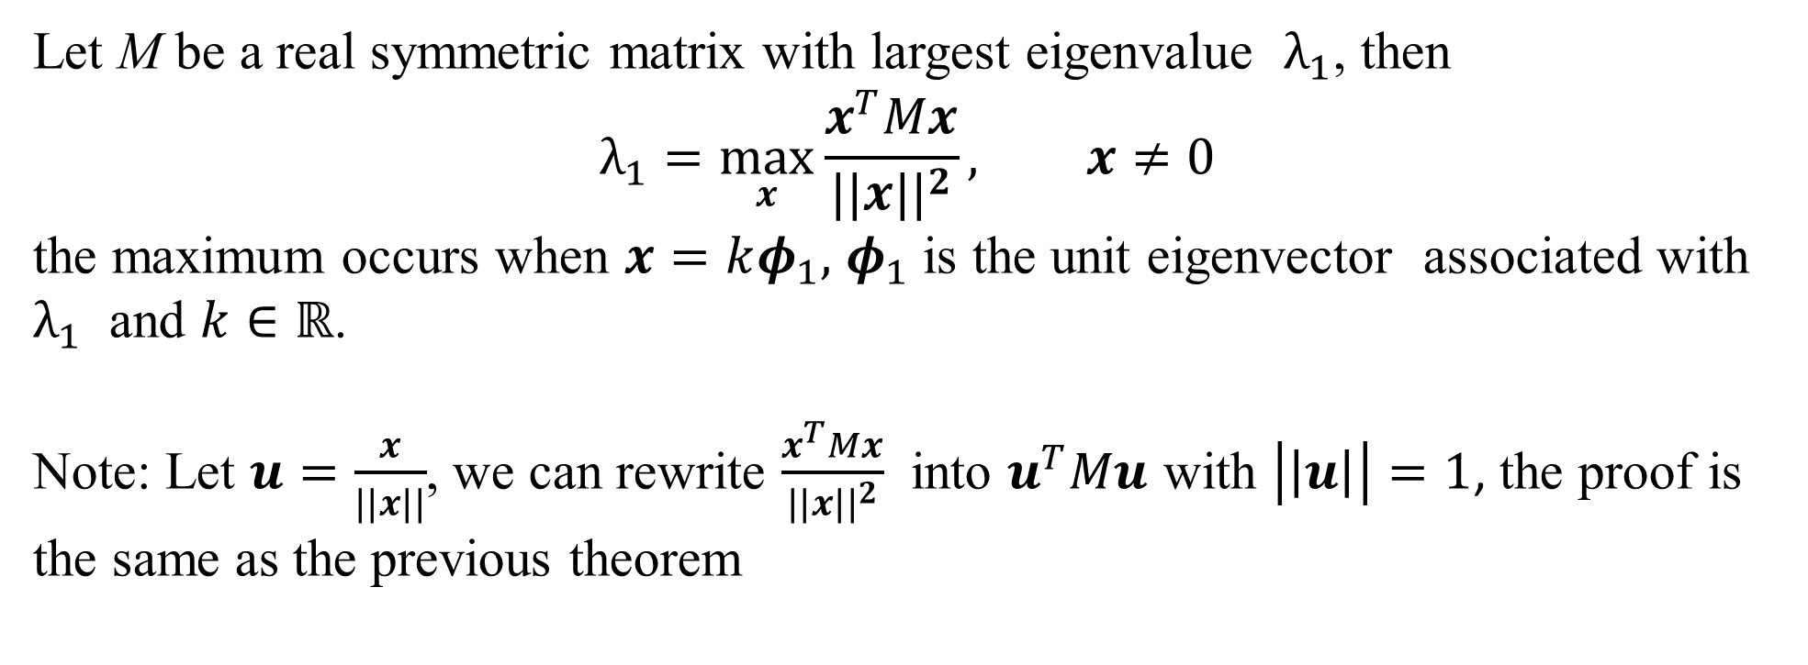
Corollary: eigendecomposition
Let M be a real symmetric matrix with largest eigenvalue $λ_{1}$, then
$$λ_{1}=\max_{x}{\frac{x^{T}Mx}{{||x||}^{2}}}, x≠0$$
the maximum occurs when $x=kφ_{1},$ $φ_{1}$ is the unit eigenvector associated with $λ_{1}$ and $k∈ℝ$.
Note: Let $u=\frac{x}{||x||}$, we can rewrite $\frac{x^{T}Mx}{{||x||}^{2}}$ into $u^{T}Mu$ with $\left|\left|u\right|\right|=1$, the proof is the same as the previous theorem

Slide 12
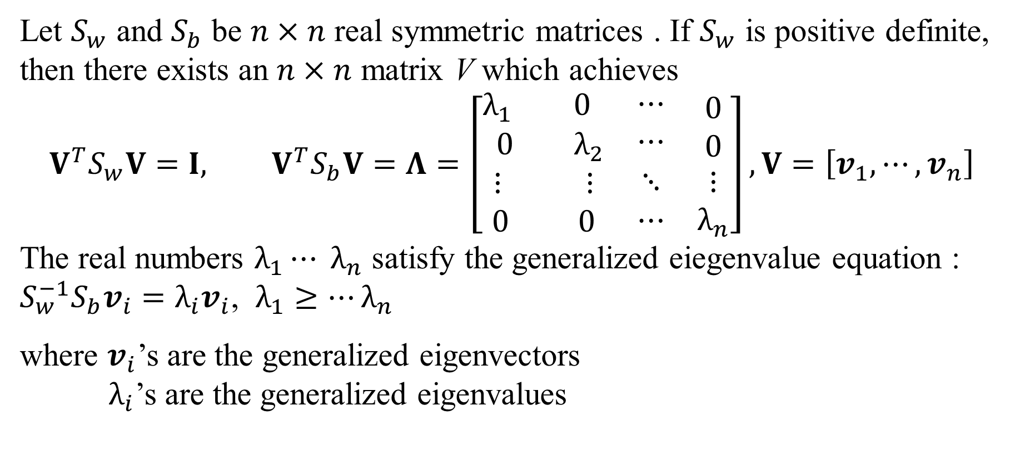
Theorem: Generalized eigendecomposition
Let $S_{w}$ and $S_{b}$ be $n×n$ real symmetric matrices . If $S_{w}$ is positive definite, then there exists an $n×n$ matrix V which achieves
$$V^{T}S_{w}V=I, V^{T}S_{b}V=Λ=\left[\begin{matrix}\begin{matrix}λ_{1} & 0 \\ 0 & λ_{2}\end{matrix} & \begin{matrix}⋯ \\ ⋯\end{matrix} & \begin{matrix}0 \\ 0\end{matrix} \\ \begin{matrix}⋮ & ⋮\end{matrix} & ⋱ & ⋮ \\ \begin{matrix}0 & 0\end{matrix} & ⋯ & λ_{n}\end{matrix}\right], V=\left[v_{1},⋯,v_{n}\right]$$
The real numbers $λ_{1}⋯ λ_{n}$ satisfy the generalized eiegenvalue equation :
${S_{w}^{−1}S}_{b}v_{i}=λ_{i}v_{i}$, $λ_{1}≥⋯λ_{n}$
where $v_{i}$’s are the generalized eigenvectors
$λ_{i}$’s are the generalized eigenvalues

Slide 13
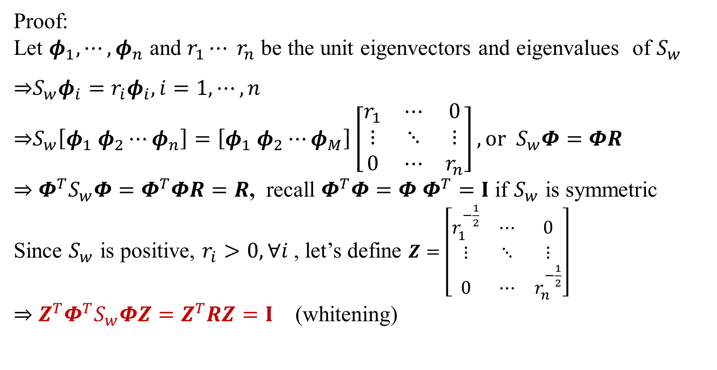
Theorem: Generalized eigendecomposition
Proof:
Let $φ_{1}, ⋯,φ_{n}$ and $r_{1}⋯ r_{n}$ be the unit eigenvectors and eigenvalues of $S_{w}$
⇒$S_{w}φ_{i}=r_{i}φ_{i}, i=1,⋯,n$
⇒$S_{w}\left[φ_{1} φ_{2}⋯φ_{n}\right]=\left[φ_{1} φ_{2}⋯φ_{M}\right]\left[\begin{matrix}r_{1} & ⋯ & 0 \\ ⋮ & ⋱ & ⋮ \\ 0 & ⋯ & r_{n}\end{matrix}\right], or S_{w}Φ=ΦR$
⇒ $Φ^{T}S_{w}Φ=Φ^{T}ΦR=R$, recall $Φ^{T}Φ={Φ Φ}^{T}=I$ if $S_{w}$ is symmetric
Since $S_{w}$ is positive, $r_{i}>0, ∀i$, let’s define $Z=\left[\begin{matrix}r_{1}^{−\frac{1}{2}} & ⋯ & 0 \\ ⋮ & ⋱ & ⋮ \\ 0 & ⋯ & r_{n}^{−\frac{1}{2}}\end{matrix}\right]$
⇒ $Z^{T}Φ^{T}S_{w}ΦZ=Z^{T}RZ=I$ (whitening)

Slide 14
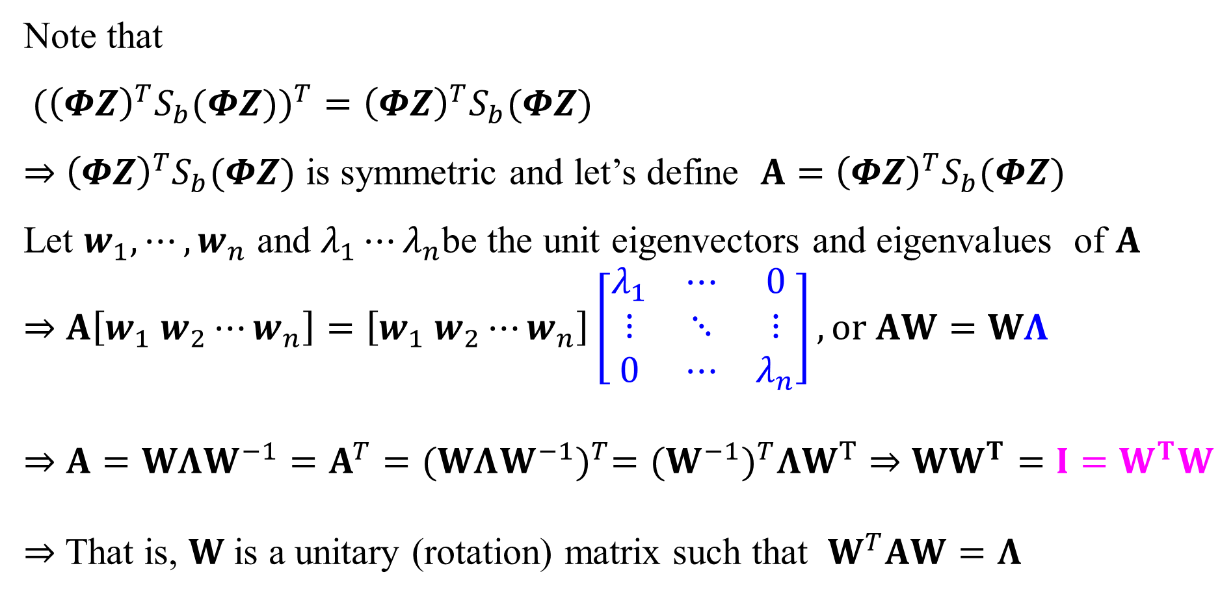
Theorem: Generalized eigendecomposition
Note that
$({{\left(ΦZ\right)}^{T}S_{b}(ΦZ))}^{T}={\left(ΦZ\right)}^{T}S_{b}(ΦZ)$
⇒ ${\left(ΦZ\right)}^{T}S_{b}(ΦZ)$ is symmetric and let’s define $A={\left(ΦZ\right)}^{T}S_{b}(ΦZ)$
Let $w_{1}, ⋯,w_{n}$ and $λ_{1}⋯λ_{n}$be the unit eigenvectors and eigenvalues of $A$
⇒ $A\left[w_{1} w_{2}⋯w_{n}\right]=\left[w_{1} w_{2}⋯w_{n}\right]\left[\begin{matrix}λ_{1} & ⋯ & 0 \\ ⋮ & ⋱ & ⋮ \\ 0 & ⋯ & λ_{n}\end{matrix}\right], or AW=WΛ$
⇒ $A=WΛW^{−1}=A^{T}={(WΛW^{−1})}^{T}={(W^{−1})}^{T}ΛW^{T}$ ⇒ $WW^{T}=I=W^{T}W$
⇒ That is, $W$is a unitary (rotation) matrix such that $W^{T}AW=Λ$

Slide 15
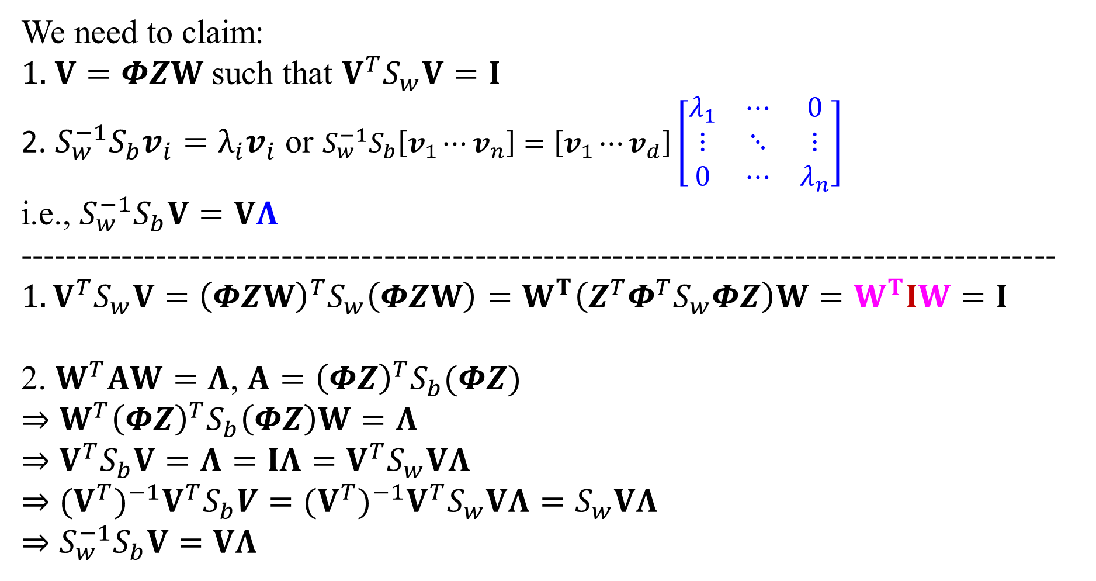
Theorem: Generalized eigendecomposition
We need to claim:
1. $V=ΦZW$ such that $V^{T}S_{w}V=I$
2. ${S_{w}^{−1}S}_{b}v_{i}=λ_{i}v_{i}$ or ${S_{w}^{−1}S}_{b}\left[v_{1}⋯v_{n}\right]=\left[v_{1}⋯v_{d}\right]\left[\begin{matrix}λ_{1} & ⋯ & 0 \\ ⋮ & ⋱ & ⋮ \\ 0 & ⋯ & λ_{n}\end{matrix}\right]$
i.e., ${S_{w}^{−1}S}_{b}V=VΛ$
-------------------------------------------------------------------------------------------$1.V^{T}S_{w}V={\left(ΦZW\right)}^{T}S_{w}\left(ΦZW\right)=W^{T}\left(Z^{T}Φ^{T}S_{w}ΦZ\right)W=W^{T}IW=I$
2. $W^{T}AW=Λ$, $A={\left(ΦZ\right)}^{T}S_{b}(ΦZ)$
⇒ $W^{T}{\left(ΦZ\right)}^{T}S_{b}\left(ΦZ\right)W=Λ$
⇒ $V^{T}S_{b}V=Λ=IΛ=V^{T}S_{w}VΛ$
⇒ ${(V^{T})}^{−1}V^{T}S_{b}V={(V^{T})}^{−1}V^{T}S_{w}VΛ=S_{w}VΛ$
⇒ ${S_{w}^{−1}S}_{b}V=VΛ$

Slide 16
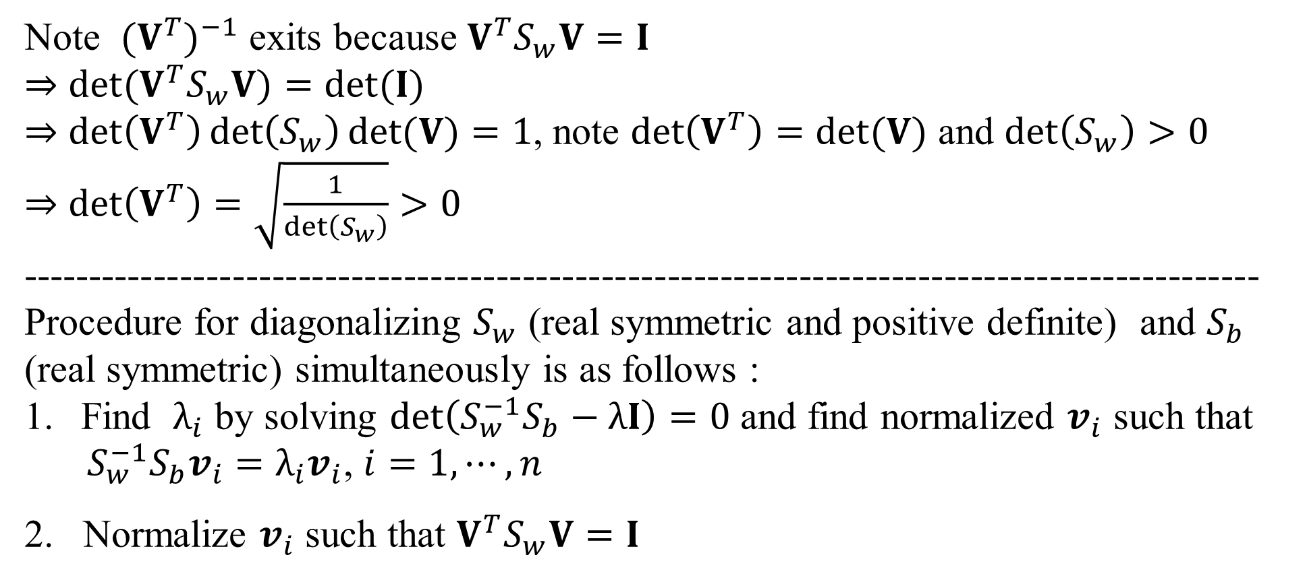
Theorem: Generalized eigendecomposition
Note ${(V^{T})}^{−1}$ exits because $V^{T}S_{w}V=I$
⇒ $det(V^{T}S_{w}V)=det(I)$
⇒ $det\left(V^{T}\right)\det\left(S_{w}\right)det⁡(V)=1$, note $det\left(V^{T}\right)=det⁡(V)$ and $\det\left(S_{w}\right)>0$
⇒ $det\left(V^{T}\right)=\sqrt{\frac{1}{\det\left(S_{w}\right)}}>0$
----------------------------------------------------------------------------------------------
Procedure for diagonalizing $S_{w}$ (real symmetric and positive definite) and $S_{b}$ (real symmetric) simultaneously is as follows :
Find $λ_{i}$ by solving $det\left({S_{w}^{−1}S}_{b}−λI\right)=0$ and find normalized $v_{i}$ such that
${S_{w}^{−1}S}_{b}v_{i}=λ_{i}v_{i}$, $i=1,⋯,n$
2. Normalize $v_{i}$ such that $V^{T}S_{w}V=I$

Slide 17
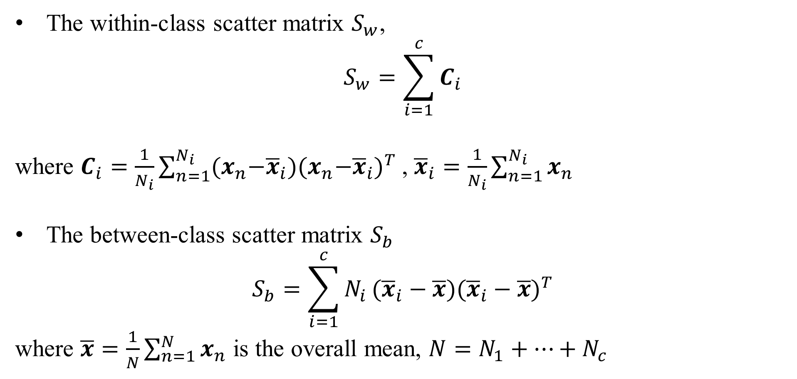
LDA for Multiple Classes c
The within-class scatter matrix $S_{w}$,
$$S_{w}=\sum_{i=1}^{c}{C_{i}}$$
where $C_{i}=\frac{1}{N_{i}}\sum_{n=1}^{N_{i}}{{(x}_{n}−{\overline{x}}_{i}){{(x}_{n}−{\overline{x}}_{i})}^{T} }$, ${\overline{x}}_{i}=\frac{1}{N_{i}}\sum_{n=1}^{N_{i}}{x_{n}}$
The between-class scatter matrix $S_{b}$
$$S_{b}=\sum_{i=1}^{c}{N_{i}}({\overline{x}}_{i}−\overline{x}){({\overline{x}}_{i}−\overline{x})}^{T}$$
where $\overline{x}=\frac{1}{N}\sum_{n=1}^{N}{x_{n}}$ is the overall mean, $N=N_{1}+⋯+N_{c}$
https://en.wikipedia.org/wiki/Linear_discriminant_analysis#Multiclass_LDA

Slide 18
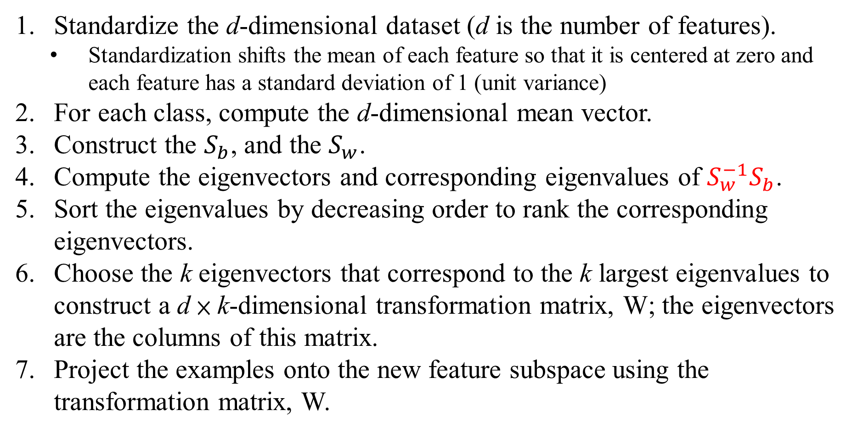
Main steps to perform LDA
Standardize the d-dimensional dataset (d is the number of features).
Standardization shifts the mean of each feature so that it is centered at zero and each feature has a standard deviation of 1 (unit variance)
For each class, compute the d-dimensional mean vector.
Construct the $S_{b}$, and the $S_{w}$.
Compute the eigenvectors and corresponding eigenvalues of ${S_{w}^{−1}S}_{b}$.
Sort the eigenvalues by decreasing order to rank the corresponding eigenvectors.
Choose the k eigenvectors that correspond to the k largest eigenvalues to construct a d × k-dimensional transformation matrix, W; the eigenvectors are the columns of this matrix.
Project the examples onto the new feature subspace using the transformation matrix, W.

Slide 19
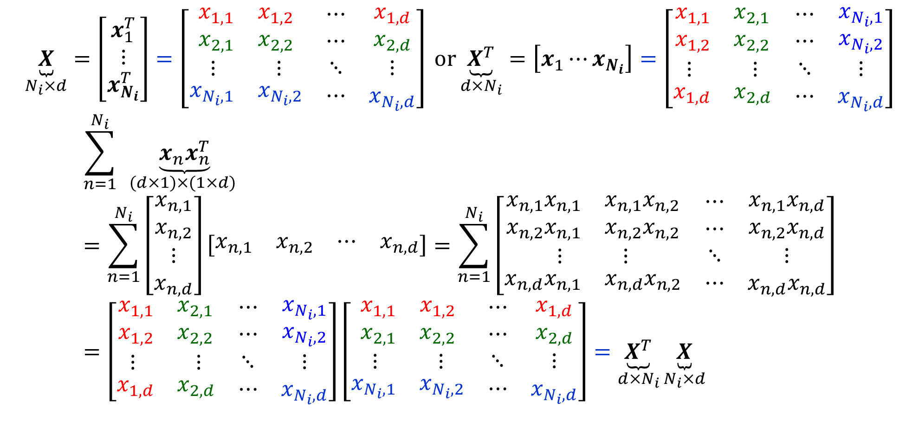
Implementation trick
$$\underset{N_{i}×d}{\underbrace{X}}=\left[\begin{matrix}x_{1}^{T} \\ ⋮ \\ x_{N_{i}}^{T}\end{matrix}\right]=\left[\begin{matrix}\begin{matrix}x_{1,1} & x_{1,2} \\ x_{2,1} & x_{2,2}\end{matrix} & \begin{matrix}⋯ \\ ⋯\end{matrix} & \begin{matrix}x_{1,d} \\ x_{2,d}\end{matrix} \\ \begin{matrix}⋮ & ⋮\end{matrix} & ⋱ & ⋮ \\ \begin{matrix}x_{N_{i},1} & x_{N_{i},2}\end{matrix} & ⋯ & x_{N_{i},d}\end{matrix}\right] or\underset{d×N_{i}}{\underbrace{X^{T}}}=\left[x_{1}⋯x_{N_{i}}\right]=\left[\begin{matrix}\begin{matrix}x_{1,1} & x_{2,1} \\ x_{1,2} & x_{2,2}\end{matrix} & \begin{matrix}⋯ \\ ⋯\end{matrix} & \begin{matrix}x_{N_{i},1} \\ x_{N_{i},2}\end{matrix} \\ \begin{matrix}⋮ & ⋮\end{matrix} & ⋱ & ⋮ \\ \begin{matrix}x_{1,d} & x_{2,d}\end{matrix} & ⋯ & x_{N_{i},d}\end{matrix}\right]$$
$$\sum_{n=1}^{N_{i}}{ }\underset{(d×1)×(1×d) }{\underbrace{x_{n}x_{n}^{T}}}=\sum_{n=1}^{N_{i}}{\left[\begin{matrix}\begin{matrix}x_{n,1} \\ x_{n,2}\end{matrix} \\ \begin{matrix}⋮ \\ x_{n,d}\end{matrix}\end{matrix}\right]\left[\begin{matrix}\begin{matrix}x_{n,1} & x_{n,2}\end{matrix} & \begin{matrix}⋯ & x_{n,d}\end{matrix}\end{matrix}\right]=\sum_{n=1}^{N_{i}}{\left[\begin{matrix}\begin{matrix}x_{n,1}x_{n,1} & {x_{n,1}x}_{n,2} \\ x_{n,2}x_{n,1} & x_{n,2}x_{n,2}\end{matrix} & \begin{matrix}⋯ \\ ⋯\end{matrix} & \begin{matrix}{x_{n,1}x}_{n,d} \\ x_{n,2}x_{n,d}\end{matrix} \\ \begin{matrix}⋮ & ⋮\end{matrix} & ⋱ & ⋮ \\ \begin{matrix}x_{n,d}x_{n,1} & {x_{n,d}x}_{n,2}\end{matrix} & ⋯ & x_{n,d}x_{n,d}\end{matrix}\right]}}=\left[\begin{matrix}\begin{matrix}x_{1,1} & x_{2,1} \\ x_{1,2} & x_{2,2}\end{matrix} & \begin{matrix}⋯ \\ ⋯\end{matrix} & \begin{matrix}x_{N_{i},1} \\ x_{N_{i},2}\end{matrix} \\ \begin{matrix}⋮ & ⋮\end{matrix} & ⋱ & ⋮ \\ \begin{matrix}x_{1,d} & x_{2,d}\end{matrix} & ⋯ & x_{N_{i},d}\end{matrix}\right]\left[\begin{matrix}\begin{matrix}x_{1,1} & x_{1,2} \\ x_{2,1} & x_{2,2}\end{matrix} & \begin{matrix}⋯ \\ ⋯\end{matrix} & \begin{matrix}x_{1,d} \\ x_{2,d}\end{matrix} \\ \begin{matrix}⋮ & ⋮\end{matrix} & ⋱ & ⋮ \\ \begin{matrix}x_{N_{i},1} & x_{N_{i},2}\end{matrix} & ⋯ & x_{N_{i},d}\end{matrix}\right]=\underset{d×N_{i}}{\underbrace{X^{T}}}\underset{N_{i}×d}{\underbrace{X}}$$
https://en.wikipedia.org/wiki/Linear_discriminant_analysis#Multiclass_LDA

Slide 20
Homework # 4
Finish Homework 4 LDA_sklearn_to_do.jpynb using skylearn.
Deadline of Homework #4: 2022/10/17 3:30pm

